Slide 1
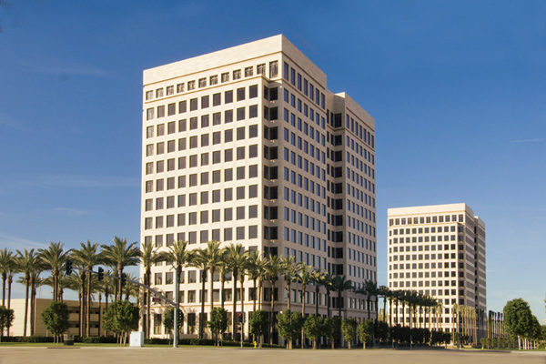

Slide 2
Century Business Solutions is a registered ISO/MSP of Wells Fargo Bank.
We have created and developed a strong relationship with First Data as our acquiring partner.

Slide 3
Who We Are
Century Business Solutions is a leading payment processor with unique, proprietary methods of integration; we designed our products not only to reduce your costs, but to increase your efficiency.
We Support

Slide 4
What We Do
We provide cutting-edge payment processing technologies and the highest level of service for all of our merchants nationwide.
Our goal at Century Business Solutions is to provide you with a broad range of card-based payment solutions tailored specifically to your business.
Our team of knowledgeable merchant consultants will assist you in identifying which payment processing options are ideal for your unique business needs.

Slide 5
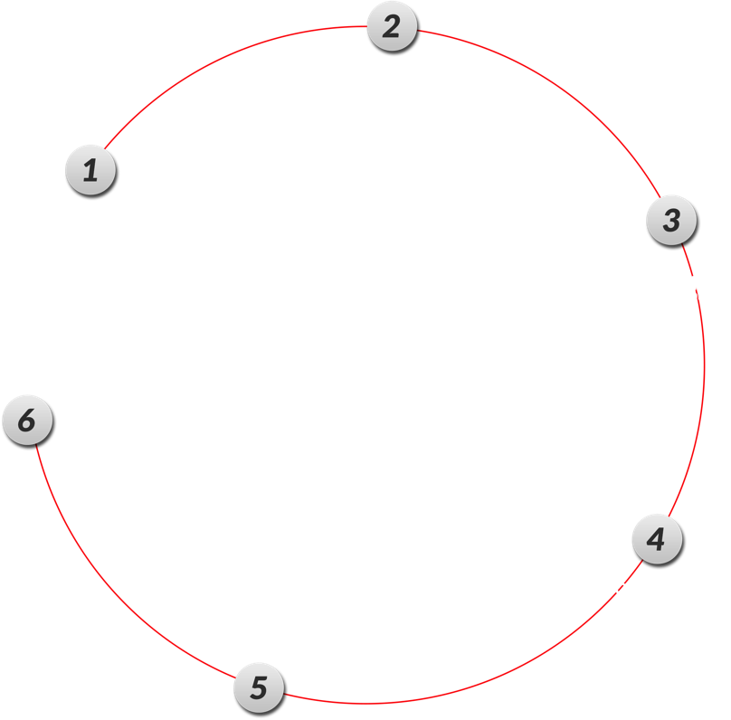
The Credit Card Payment Process

Slide 6
Understanding Key Terms
Interchange Fees
These are the variable fees charged by card organizations for processing transactions. Factors that affect individual interchange levels include card type, information included within a transaction, and whether the transaction came from a swiped or a keyed-in card.
Assessment Fees
An assessment fee is retained by card-issuers like Visa, MasterCard, American Express, and Discover.
Member Bank
A member bank has a merchant processing relationship with Visa and MasterCard. Member banks can issue merchant accounts directly to merchants.
Acquirer
This is a network that processes a transaction on behalf of a merchant, e.g., First Data.

Slide 7
Excellent Customer Service
Unlimited 24/7 customer service provided by our in-house support team in California. We NEVER outsource.
We have dedicated support members that are knowledgeable in different respective solutions, so an expert will always be available to you.
We will answer any questions you have at any time, as your satisfaction ensures our success.

Slide 8
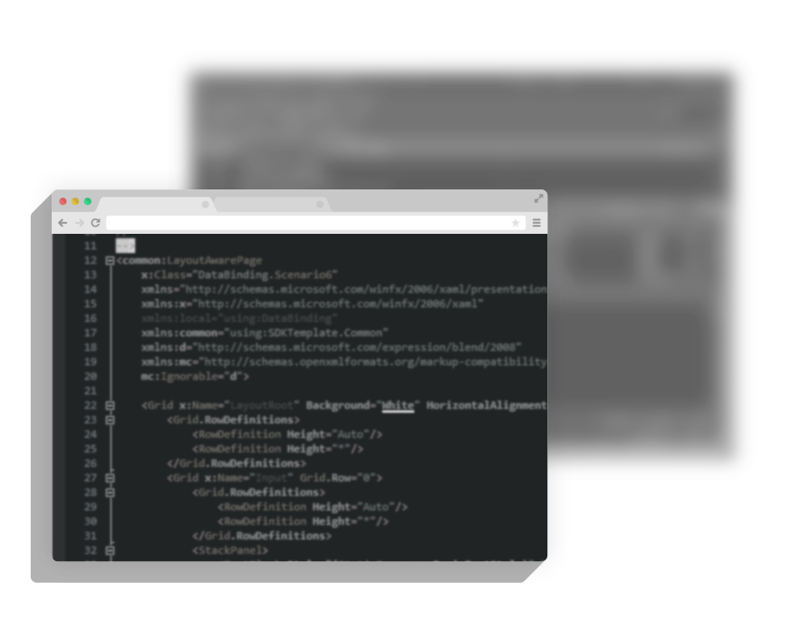
Development Team
Unlike other merchant services providers, Century Business Solutions has its own in-house software development team that keeps up with the latest Visa/MasterCard regulations.
Our developers program payment solutions specifically to optimize the Visa and MasterCard interchange levels.

Slide 9
Chargeback Management
Typical Process
Century Business Solutions’ Process
A cardholder or an issuing bank files a chargeback.
4 to 5 days later, the merchant receives a notification of this in the mail.
A cardholder or an issuing bank files a chargeback.
24 to 48 hours later, one of our agents contacts the merchant by phone and by email.
Our agent will address exactly how to respond, giving personalized service for each unique case.
One of our customer service representatives will look further into the case and advise the merchant about filing a rebuttal.
If a merchant forgets to file a rebuttal, an agent will reach out and make sure the merchant knows about this before the window to file closes.

Slide 10
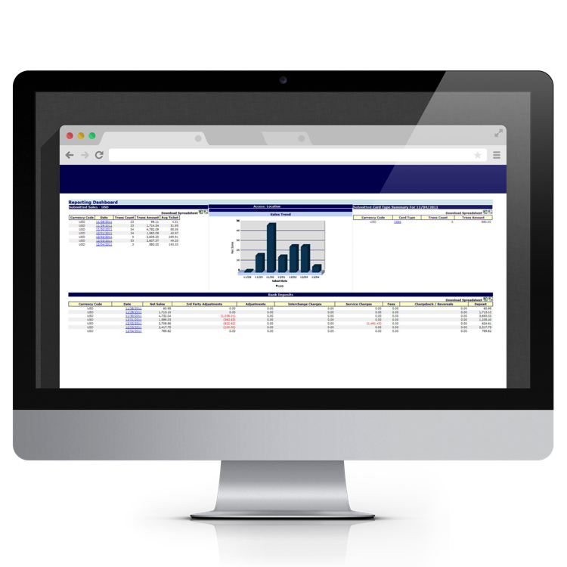
Online Reporting
Client line reporting for funds deposited into your bank account.

Slide 11
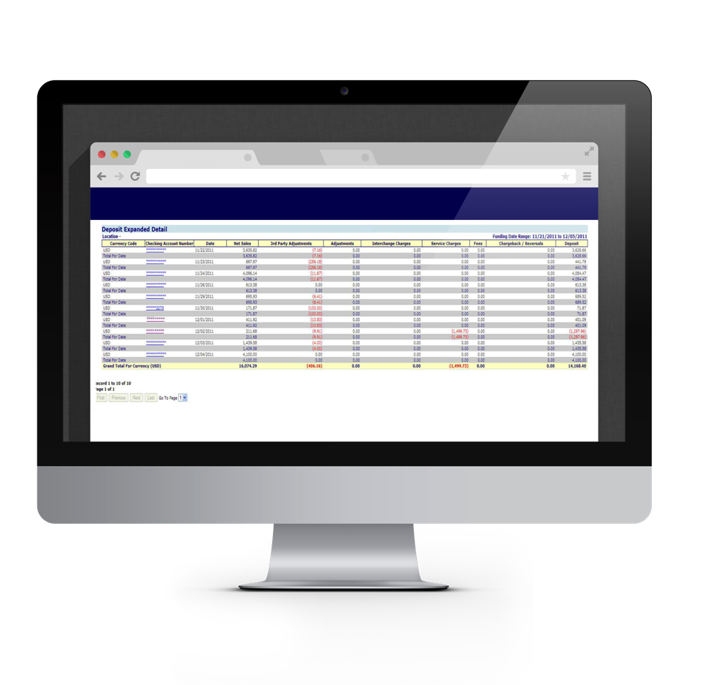
Online Reporting
Day-by-day breakdown, showing the total amount deposited into your account.

Slide 12
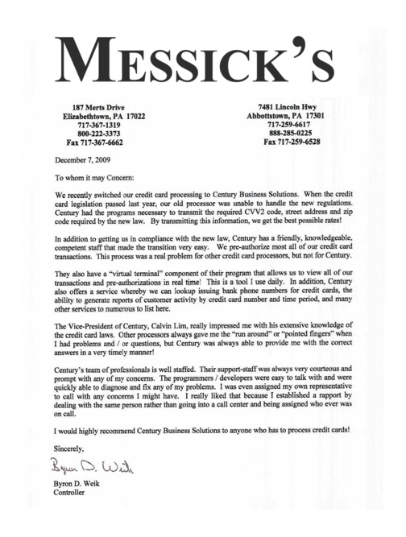
References
Real, unsolicited letters from long-time customers.
Building long-term relationships that last!

Slide 13
No Contracts
Most processors require a contract, locking a merchant into predetermined rates and coverage that often don’t make sense for that merchant’s particular business.
With Century Business Solutions, there is no contract required. We are confident that we bring our merchants the highest quality of service, the best solutions, and unrivaled support. In this manner, we let our service speak for itself.

Slide 14
The Next Step: Your Responsibility
Live-signing procedure to ensure the protection of your privacy and confidential information.
Application for a new merchant number.

Slide 15
The Next Step: Our Responsibility
Underwriting process.
Installation of our systems at your convenience. You choose your preferred date/time (no additional charge).
Training provided for your staff on your selected date/time (no additional charge).
Continuous support of your account and payment related software (no additional charge).

Slide 16
Call Us 888 500-7798
www.centurybizsolutions.com 20 Pacifica, Suite 1450 Irvine, CA 92618

