Slide 1
MAS90/MAS200 Integrated Solution SAGE 100 STANDARD & ADVANCED
We Guarantee our eBizCharge credit card module in MAS90 (SAG100 Standard)/MAS200 (SAGE100 Advanced) will reduce your processing costs significantly and increase your profitability.
We have developed integrated credit card processing solutions with many ERP systems, including MAS90 (SAGE100 Standard)/MAS200 (SAGE100 Advanced).
As a SAGE Certified Development Partner, Century Business Solutions brings you an integrated solution for MAS90 (SAGE100 Standard) and MAS200 (SAGE100 Advanced) accounting programs.
Our integrated solutions do not require you to change your processes or retrain staff, as the look and feel of the software does not change at all.

Slide 2
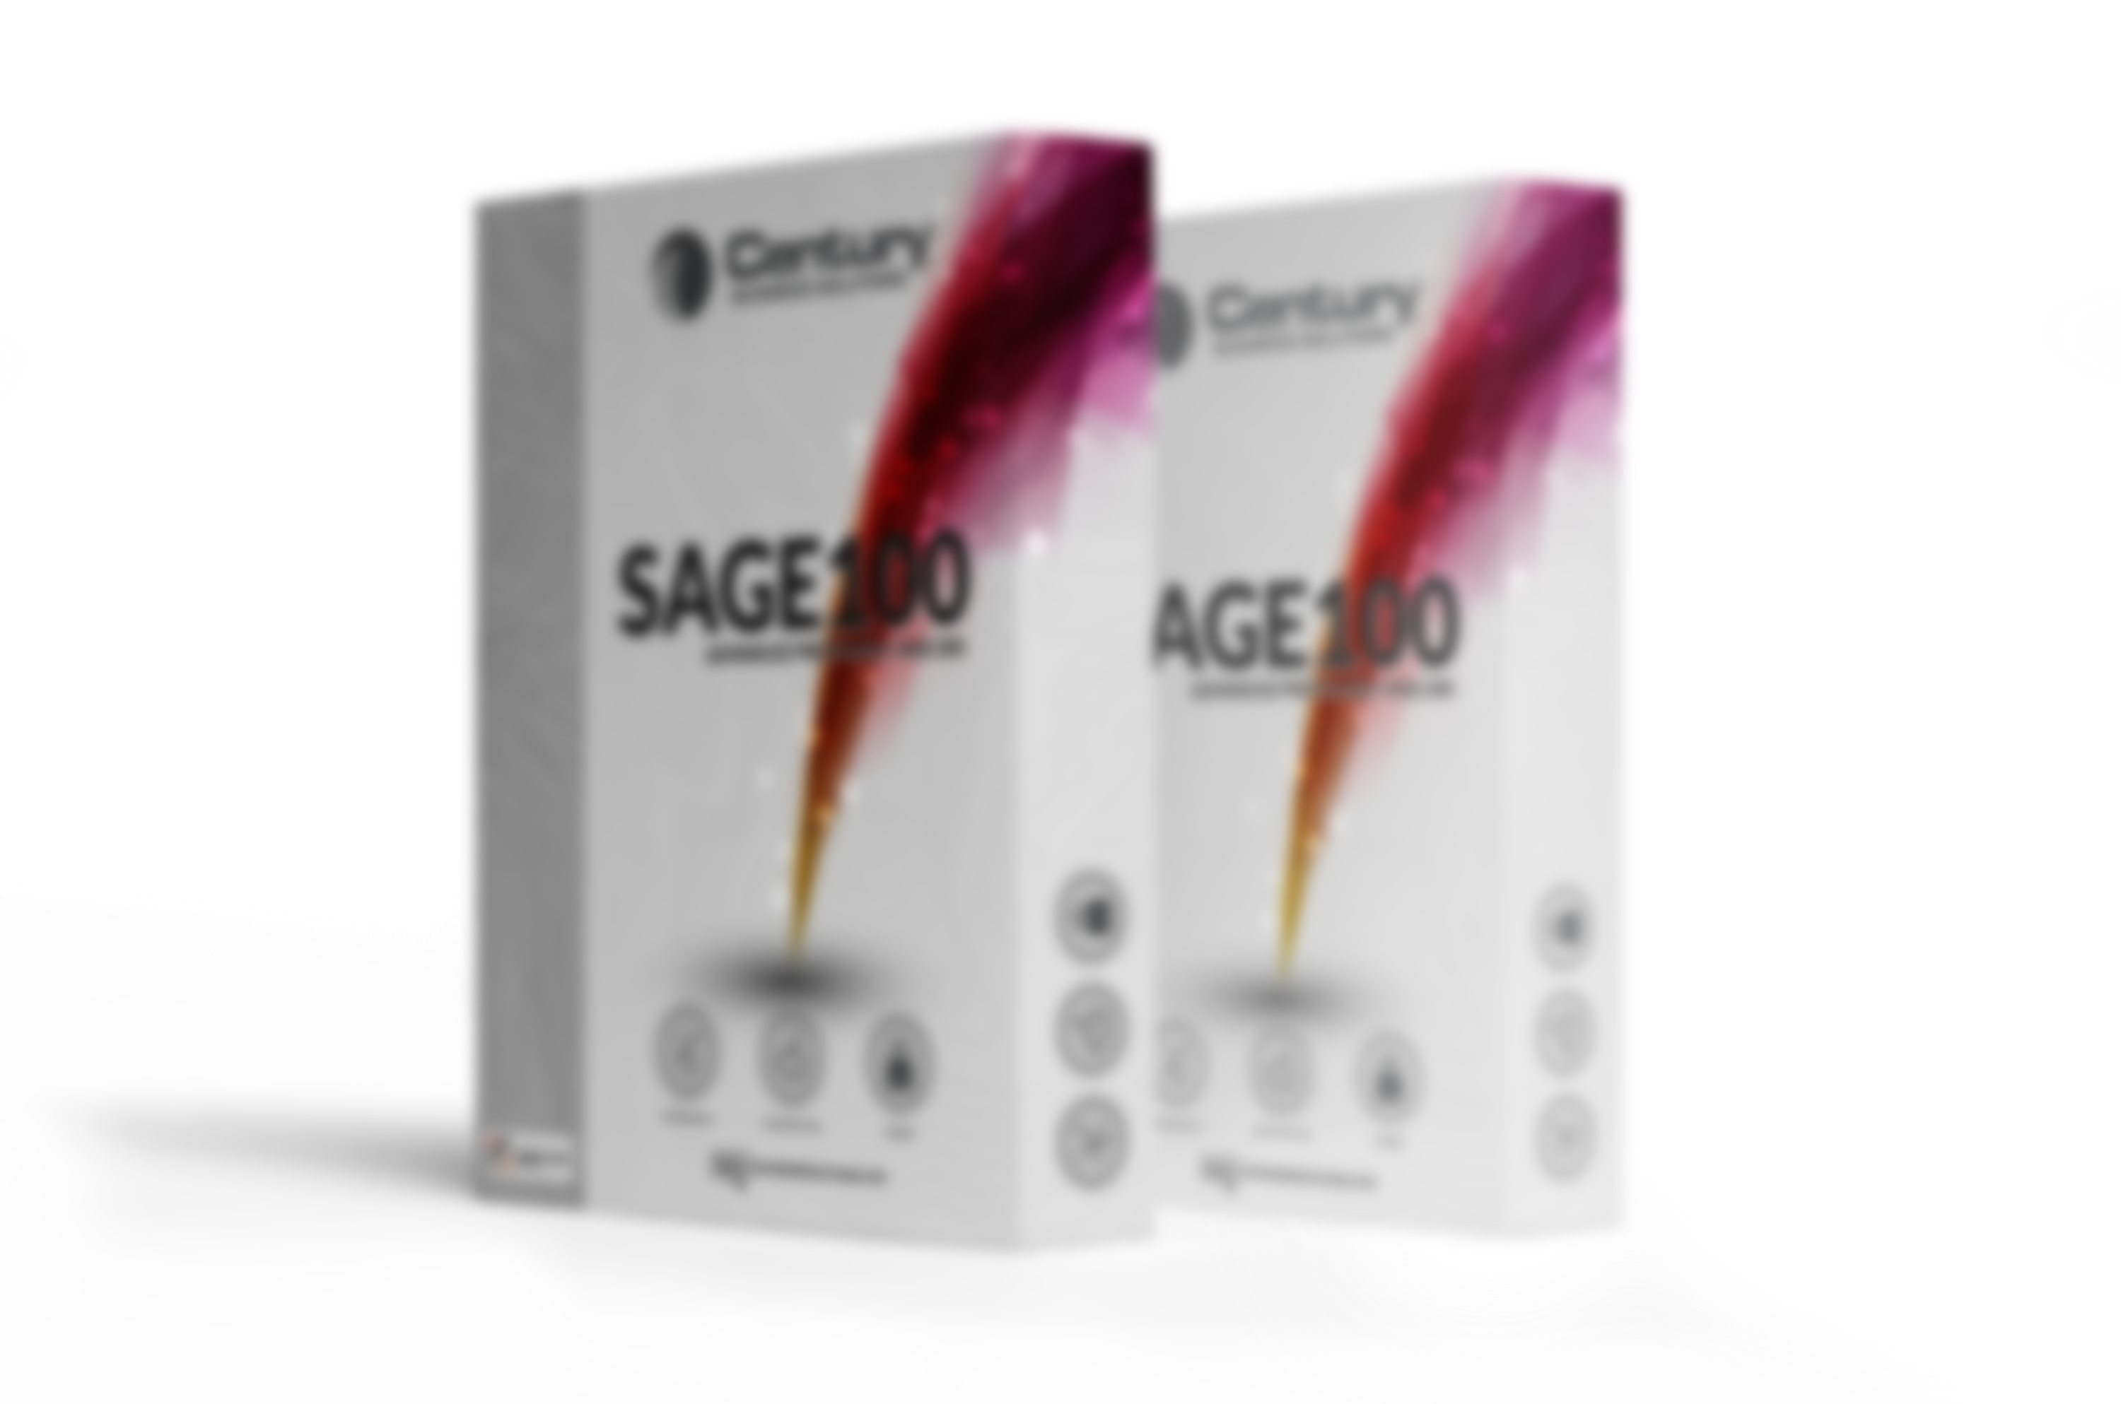
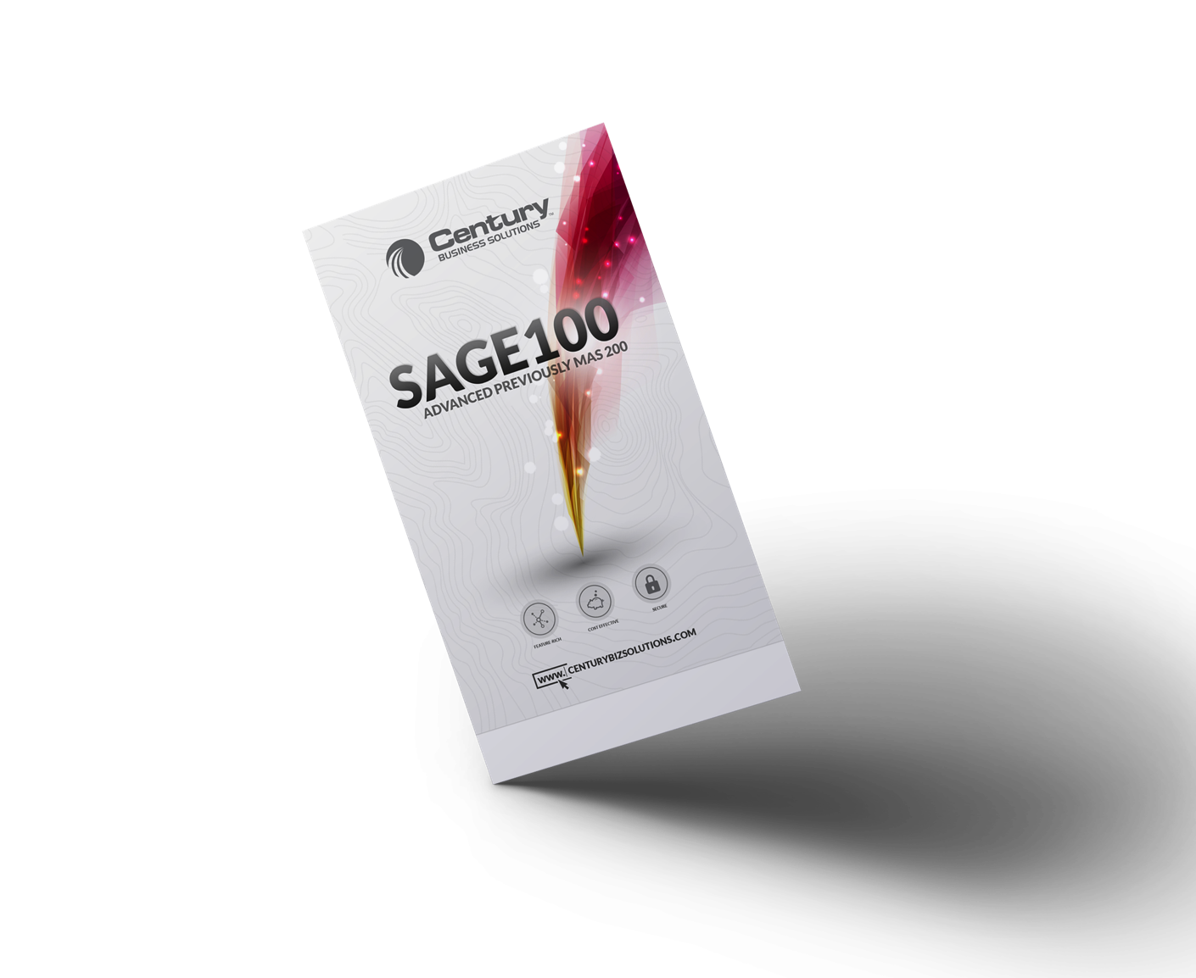
MAS90/MAS200 Integrated Solution SAGE 100 STANDARD & ADVANCED
Record credit card authorizations and deposits in:
S/O Sales Order Entry
S/O Invoice Data Entry
Cash Receipts

Slide 3
MAS90/MAS200 Integrated Solution SAGE 100 STANDARD & ADVANCED
Pay open invoices or create pre-payments with a credit card in A/R Cash Receipts Entry
Print settled transactions in A/R Credit Settlement Report
Capture credit card authorizations for settlement in S/O Daily Sales Reports and Updates
Our integrations run invisibly inside your MAS program; no retraining is necessary.
Qualify all types of credit and debit cards—including corporate and government purchasing cards—at the lowest Visa and MasterCard interchange levels.

Slide 4
MAS90/MAS200 Integrated Solution SAGE 100 STANDARD & ADVANCED
The freedom of processing without a binding contract
No daily discount (fees debited once a month only)
No installation fees and no software update fees
A multitude of searching and reporting tools from our own gateway, eBizCharge.
Unlimited 24/7 customer service provided by our in-house client services team in California. No Outsourcing

